Slide 1
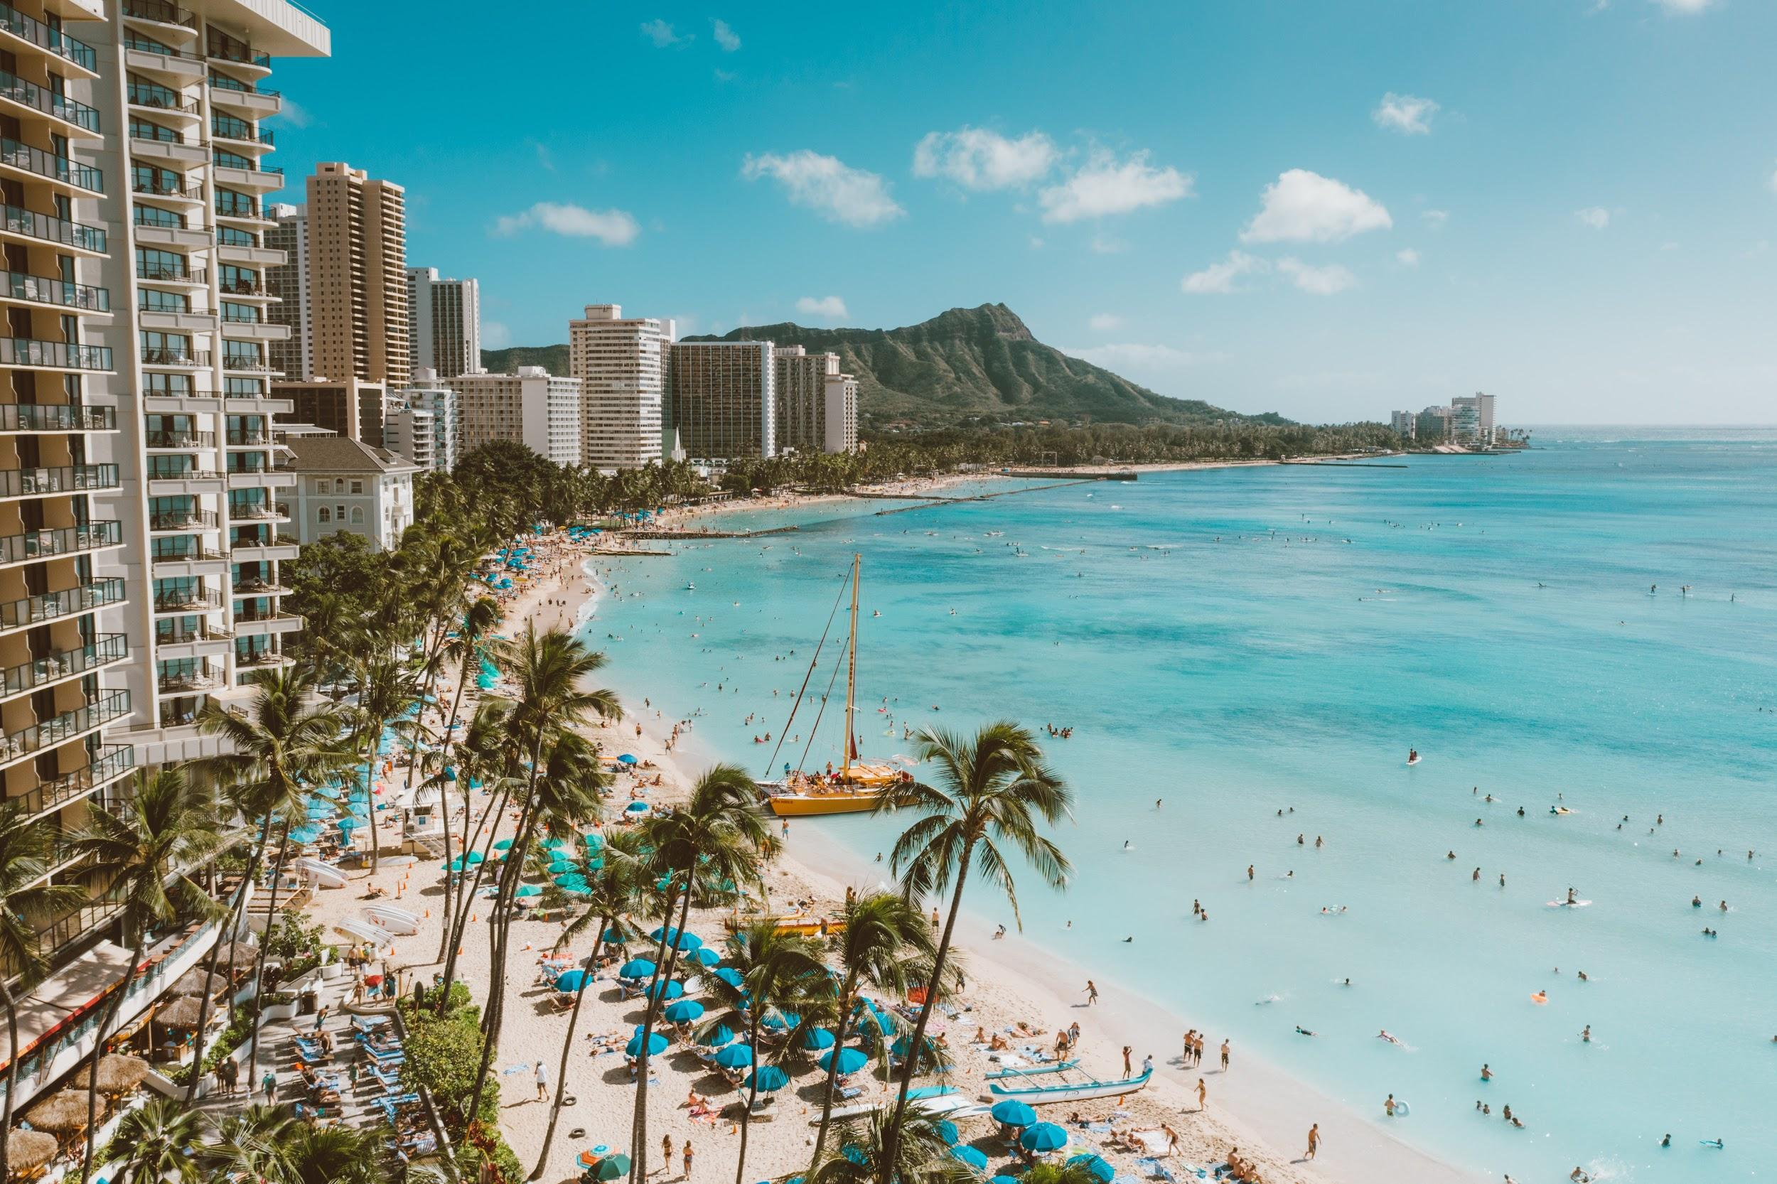
Hawaii: To Airbnb or not to Airbnb
Group 4: Xiaoran Sun, Ryan Fertig, John Gully, James LaBouliere

Slide 2
Why Hawaii?
Hawaii is one of the premier travel destinations on the planet with visitors from around the globe arriving every day. According to Hawaii's Department of Business, Economic Development and Tourism(DBEDT), the State of Hawaii received a total of 842,927 visitors during the month of June 2022. Tourism plays a significant role in the Hawaiian economy and investing in Airbnb Hawaii becomes a financial gain for a lot of residents and non-residents. There are more and more people considering purchasing a second house or investment property to rent out to tourists as an Airbnb business.

Slide 3
Overview
The purpose of this analysis is to facilitate decision making on consideration for running a short term rental property in the area. Short term rentals offer a unique alternative to traditional hotel/motel stays and present the opportunity for a property owner to generate income from an otherwise unoccupied residence or room. Utilizing several datasets taken from Inside Airbnb (http://insideairbnb.com/get-the-data) for Hawaii, the goal is to answer several questions pertinent to entry into the short term rental business model:
Which neighborhoods have the most rental properties, and which neighborhoods generate the most revenue?
Which property/room type is booked most often?
What are the most influential factors (amenities) for drawing rentals and commanding a higher price point?
When is the peak season for rentals, and when can maintenance and repairs be performed?

Slide 4
Exploring the Data

Slide 5
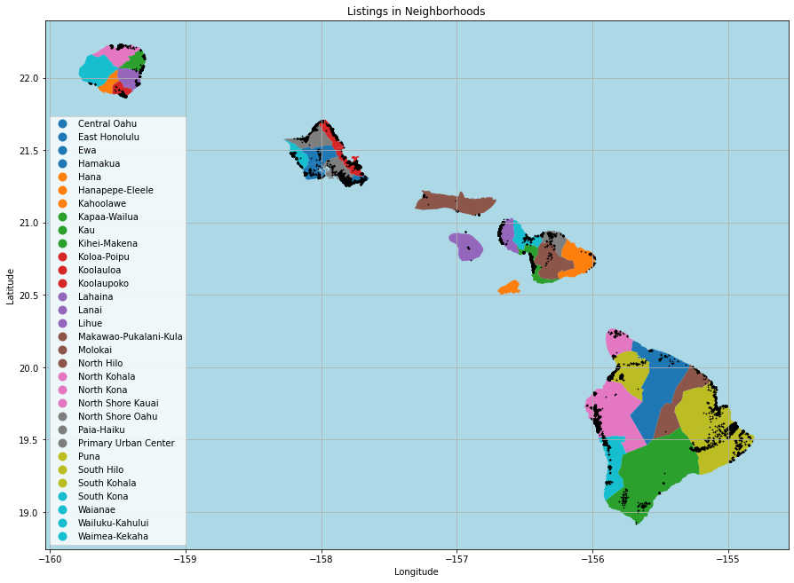
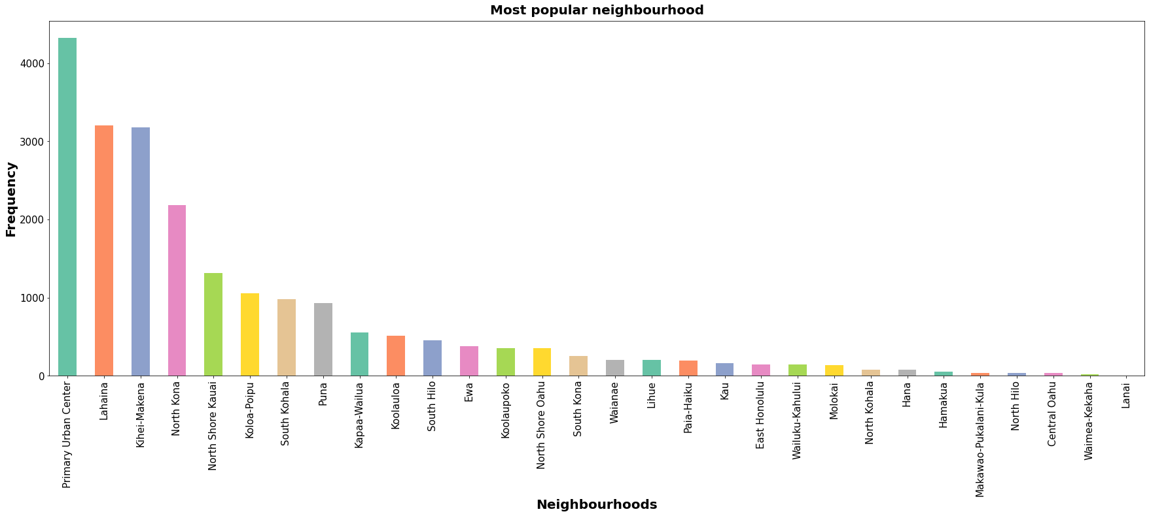
Neighborhoods

Slide 6
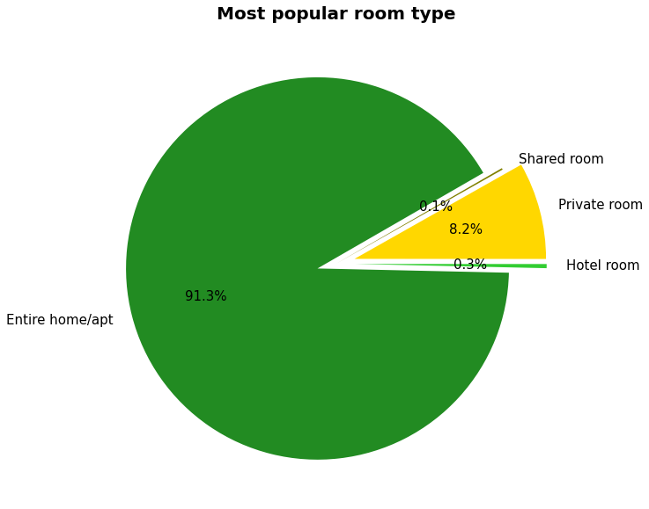
Most Popular Rentals

Slide 7
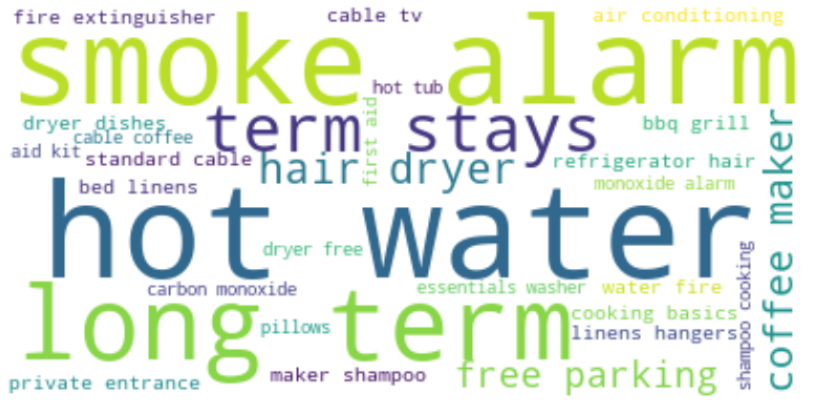
Amenities

Slide 8
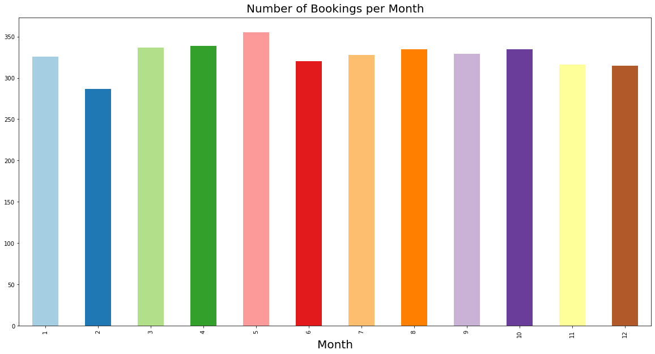
Peak Season

